Slide 1
Stepwise Approach to Build a Forecasting Model in R
Paurush Gaur

Slide 2
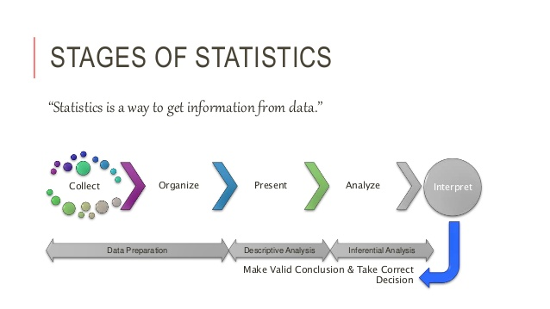
Total Duration- 3 hours
Forecasting and Prediction
What is Forecasting?
Difference between Forecasting and Prediction
Introduction and Concepts
What is Time Series?
Components of Time Series
Terms used in Time Series
Stationary Series
Time Series Decomposition
ARIMA Forecasting Procedure
Stepwise approach to build a Time Series Model
Check Stationarity of Series
How to make ACF and PACF Plots
Pure AR Model
Pure MA Model
ARMA and ARIMA Model

Slide 3
Forecasting and Prediction
Many a times, forecasting and prediction are used interchangeably
The dictionary/ literary meaning for both the words is also same
From Analytics perspective, there are some subtle differences:
Forecasting: Purpose of forecasting is to estimate a value in future using historical and current values. Comparatively less granular; Mandatory to have time dependent and ordered data
Example- "How much sales can we expect in next month?“
Prediction: Predictive modelling are used to understand relationships between variables. These relation is used to estimate current or future value. More granular;
For example –” "Who are the customers who are likely to buy a product in next month?“
There are two basic types of “time domain” models.
Models that relate the present value of a series to past values and past prediction errors - these are called ARIMA models (for Autoregressive Integrated Moving Average).
Ordinary regression models that use time indices as x-variables. Example – using Consumer Price Index, Dow Jones Industrial Average, New York Stock Exchange etc.
Notes:
When using regression for prediction, we are often considering time series data and we are aiming to forecast the future. There are a few issues that arise with time series data but not with cross-sectional data that we will consider in this section.
Using a regression model to forecast time series data poses a challenge in that future values of the predictor variable (Income in this case) are needed to be input into the estimated model, but these are not known in advance.

Slide 4
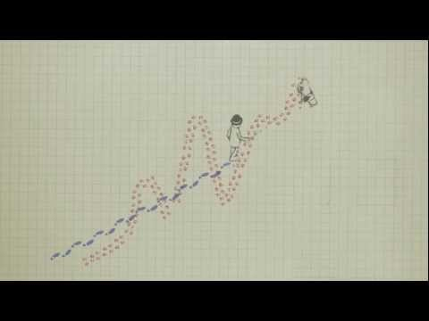
Time Series - Introduction
What is Time Series
A time series is a data series consisting of several values over a time interval. For example, weekly sales of cars, monthly profit of a company, etc.
The basis of performing a time series analysis is the assumption that in a time series value at any given point of time is a result of its historical values.
Components of a Time Series
Trend {T(t)}: Constantly increasing or decreasing OR first decreasing for a considerable time period and then decreasing.. The trend should be identified and then removed.
Seasonality{S(t)}: Repeating pattern with fixed period. Examples, sales in festive seasons, sales of umbrella during monsoon. The time-series should be de-seasonalized.
Random Variation/Irregular{I(t)}: Unexplained variation in the time-series which is totally random. Example – Earthquake
https://www.youtube.com/watch?v=e0vj-0imOLw

Slide 5
Important Characteristics of Time Series Data
Important Characteristics to Consider First
Some important questions to first consider when first looking at a time series are:
Is there a trend, meaning that, on average, the measurements tend to increase (or decrease) over time?
Is there seasonality, meaning that there is a regularly repeating pattern of highs and lows related to calendar time such as seasons, quarters, months, days of the week, and so on?
Are their outliers? In regression, outliers are far away from your line. With time series data, your outliers are far away from your other data.
Is there constant variance over time, or is the variance non-constant?

Slide 6
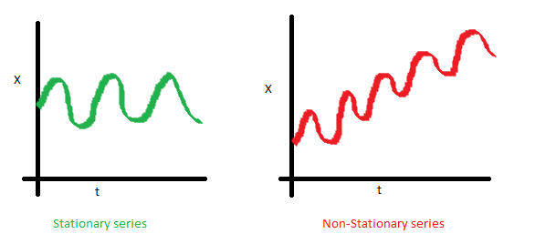
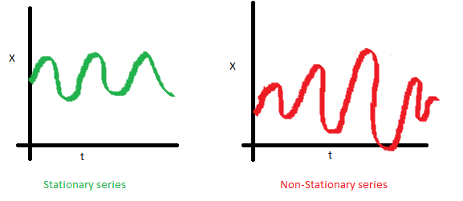
Terminologies related to Time Series
Stationary Series
A stationary series is one whose mean and variance of the series is constant over time i.e.,
The mean of the series should not be a function of time rather should be a constant.
The variance of the series should not a be a function of time.
Notes:
The series has to be stationary before building a time series with ARIMA. Most of the time series are non-stationary. If series is non-stationary, we need to make it stationary with detrending, differencing etc.Why Stationary?
To calculate the expected value, we generally take a mean across time intervals. The mean across many time intervals makes sense only when the expected value is the same across those time periods. If the mean and population variance can vary, there is no point estimating by taking an average across time.

Slide 7
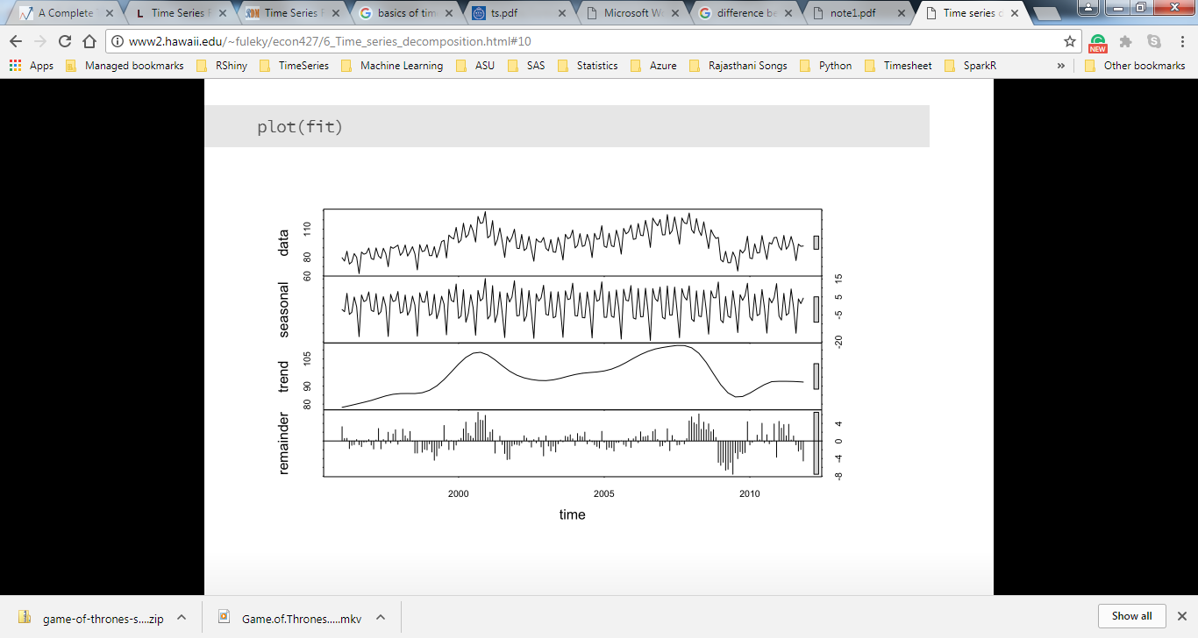
Time Series Decomposition
Decomposition
Within a given Time Series, underlying pattern can also be broken down into sub patterns to identify the component factors that influence each of the values in a series.
Mathematical representation of the decomposition approach is:
Y_{t} is the time series value (actual data) at period t
S_{t} is the seasonal component at period t
T_{t} is the trend cycle component at period t
E_{t} is the irregular (remainder) component at period t
* Remainder and random component are used interchangeably
Notes:
The underlying pattern can also be broken down into sub patterns to identify the component factors that influence each of the values in a series.
This procedure is called decomposition.
Decomposition methods usually try to identify two separate components of the basic underlying pattern that tend to characterize economics and business series.
Trend Cycle
Seasonal Factors
The trend Cycle represents long term changes in the level of series.
The Seasonal factor is the periodic fluctuations of constant length that is usually caused by known factors such as rainfall, month of the year, temperature, timing of the Holidays, etc.
The decomposition model assumes that the data has the following form:
Data = Pattern + Error
= f (trend-cycle, Seasonality, error)
The exact functional form depends on the decomposition model actually used. Two common approaches are:
Additive Model
Y_{t =}S_{t +} T_{t +} E_{t}
Multiplicative Model
Y_{t =}S_{t *} T_{t *} E_{t}
An additive model is appropriate if the magnitude of the seasonal fluctuation does not vary with the level of the series
Multiplicative model is more prevalent with economic series since most seasonal economic series have seasonal variation which increases with the level of the series
Transformations can be used to model additively, when the original data are not additive.
We can fit a multiplicative relationship by fitting an additive relationship to the logarithm of the data, since if
Y_{t =}S_{t *} T_{t *} E_{t}
Then
LogY_{t =}LogS_{t +} LogT_{t +} LogE_{t}

Slide 8
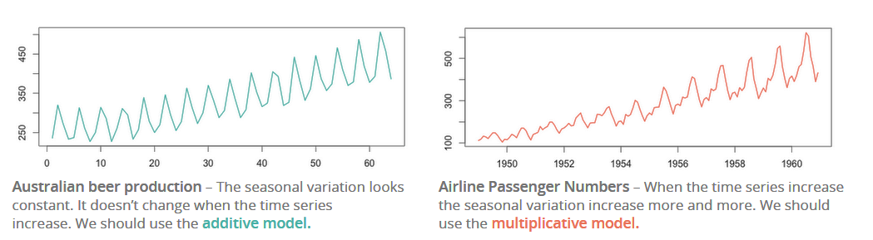
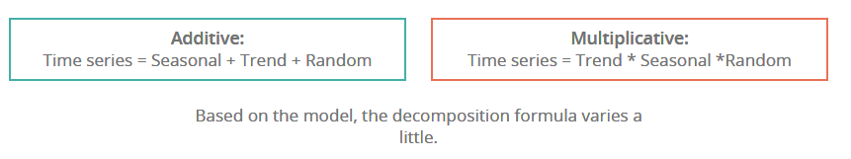
Time Series Models
Two different types of models are generally used for a time series viz. Multiplicative and Additive models.
Multiplicative Model: Y(t) = T(t)× S(t)×C(t)× I(t)
Additive Model: Y(t) = T(t) + S(t) + C(t) + I(t)

Slide 9
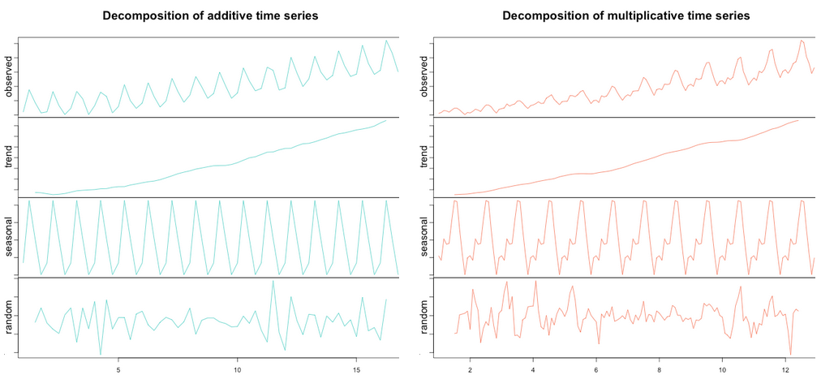
Decomposition of Additive and Multiplicative Time Series
* Remainder and random component are used interchangeably

Slide 10

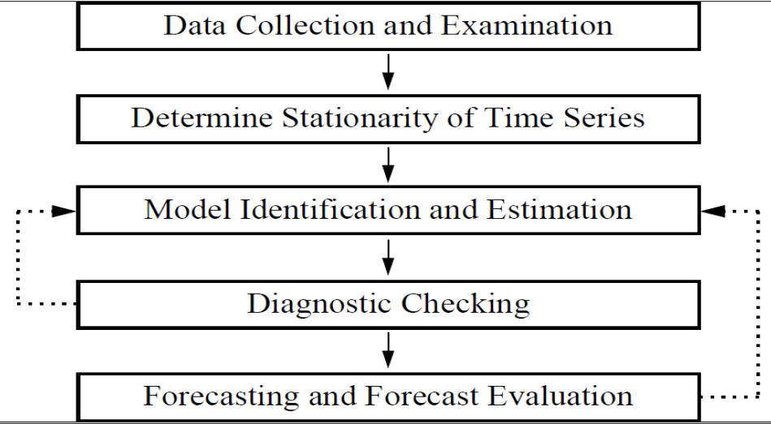
Arima Forecasting Procedure
Time Series Decomposition
Before building the Time Series Model, Install the below packages in R.
install.packages("xlsx")
install.packages("tseries")
install.packages("forecast")
install.packages("MASS")
install.packages("fUnitRoots")

Slide 11
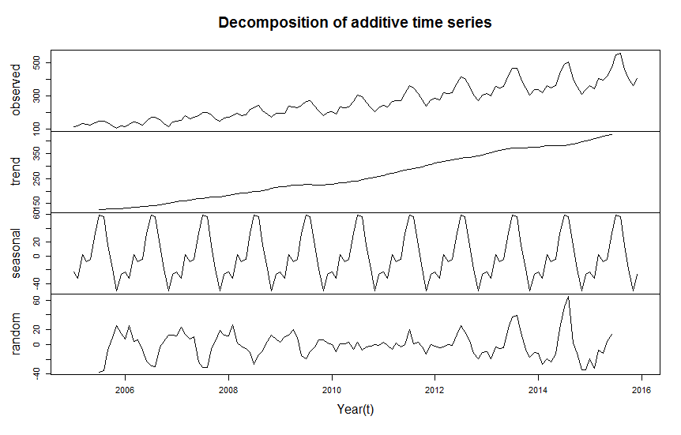
Stepwise approach to build a Time Series Model:
Time Series Decomposition
Convert the dataset into time series: The ts() function in R is used to convert a numeric column of dataset in time series object. For example
T_Data <- ts(Data$Count, start = c(2014,1), end = c(2017,5), frequency = 12)
Here are the parameter details of ts function:
Start- Time from which the data series is starting.
End- Time at which the data series is ending.
Frequency- Number of observations per unit time. (1=annual, 4= quarterly, 12=monthly, etc.)
Analyze the time series object: Decompose the time series into various components.
The decompose() function in R is used to decompose the series into trend, seasonality and random. We can visualize the decomposed parts by using plot() function.
For example:
plot(decompose(T_Data), xlab= "Year(t)")

Slide 12
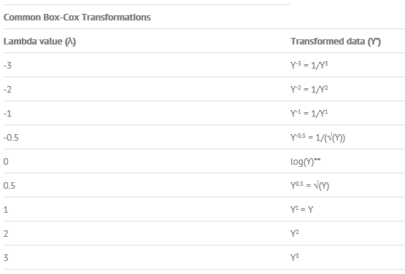
Stepwise approach Contd..
Time Series Decomposition
Stationarize a time series: In order to build a time series model we first have to make the series stationary.
A stationary series is one whose mean and variance are constant over time
To stationarize a time series we have to perform below steps.
Series Transformation: we can transform the series using boxcox() function. It is used to stabilize the variance in series.
Lambda(λ) is the parameter of boxcox() function and its value decides what kind of transformation is required.
R code: lambda <- BoxCox.lambda(T_Data)
plot.ts(BoxCox(T_Data, lambda = lambda))
T_Data_box <- BoxCox(T_Data, lambda = lambda)
Differencing: In order to stabilize mean, we go for differencing.
T_Data_box _d <- diff(T_Data_box)

Slide 13

Stepwise approach Contd..
Time Series Decomposition
Check Stationarity of Time Series: We need to perform augmented dickey fuller test to check the stationarity of newly transformed series.
Adf.test() is the function under fUnitRoots package to perform stationarity check.
R Code: adf.test(T_Data_box _d)
Here is the output of the test.
If the p-value is less than or equal to .05 then we accept the alternative hypothesis i.e. series is stationary.

Slide 14

Stepwise approach Contd..
Time Series Decomposition
Create ACF and PACF Plots: ACF stands for auto correlation function whereas PACF stands for partial auto correlation function. ACF and PACF are very useful in time series as they help us to decide what kind of time series model is appropriate for forecasting.
ACF(q): The autocorrelation function (ACF) is a set of correlation coefficients between the series and lags of itself over time.
PACF(p): The amount of correlation between a variable and a lag of itself that is not explained by correlations at all lower-order-lags. For example, if we are regressing a variable Y on other variables X1, X2, and X3, the partial correlation between Y and X3 is the amount of correlation between Y and X3 that is not explained by their common correlations with X1 and X2.
Autoregressive (AR) models:
An autoregressive model of order “p” AR(p)
Let Current value of X_{t} can be found from past values, plus a random e_{t.}
Like a multiple regression model, but X_{t} is regressed on past values of X_{t.}
The AR(1) Model
A simple way to model dependence over time is with the “autoregressive model of order 1” “This is an OLS model of X_{t} regressed on lagged Xt-1"

Slide 15
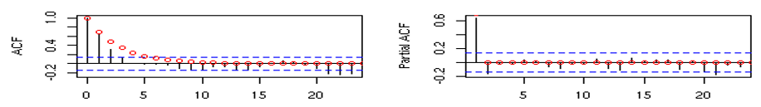

Stepwise approach Contd..
Time Series Decomposition
Identifying an AR process:
The autocorrelations of a pure AR(p) process should decay gradually at increasing lag length. However, the partial autocorrelations of a pure AR(p) process do display distinctive features. The partial autocorrelogram should ‘die out’ after p lags.
Moving-average (MA) models: A moving-average model of order “q” MA(q)
“Current value of X_{t} can be found from past shocks/error (e), plus a new shock/error (e_{t})"
“The time series is regarded as a moving average (unevenly weighted, because of different coefficients) of a random shock series e_{t}" The MA(1) model

Slide 16
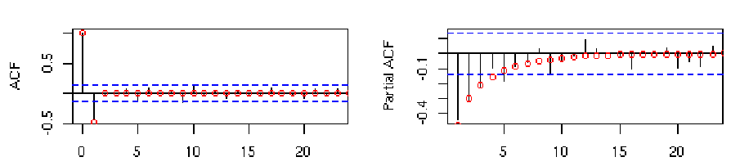
Stepwise approach Contd..
Time Series Decomposition
Identifying a MA process:
The behavior of correlograms and partial autocorrelograms for pure MA(q) processes is the reverse of that for pure AR processes. The autocorrelogram of a pure MA(q) process should ‘die out’ after q lags. The partial autocorrelogram of a pure MA process decays slowly over time.
To calculate ACF and PACF in R, run below functions:
acf(T_Data_box _d)
pacf(T_Data_box _d)
General Theoretical ACF and PACF of ARIMA Models:

Slide 17
Stepwise approach Contd..
Time Series Decomposition
6. Choose Time Series Model:
ARMA models
ARMA models are suitable for time series whose mean and variance are constant.
A mixture of these two types of model would be referred to as an autoregressive moving average model (ARMA)p,q, where p is the order of the autoregressive part and q is the moving average order.
Mixed ARMA models "An ARMA process of the order (p, q)"
ARIMA Model: It is a type of ARMA model which can be used with some kinds of non-stationary data.
Useful for series with stochastic trends First order or “simple” differencing
The “I” stands for integrated in ARIMA which means we are differencing the series.
We typically write ARIMA Model as ARIMA(p, d, q) where:
"p is the order of autoregressive terms"
"d is the order of differencing"
"q is the number of moving average terms"
e.g. ARIMA(1,1,0) is a first order Autoregressive model with one order of differencing.

Slide 18
Stepwise approach Contd..
Time Series Decomposition
Which ARIMA(p,d,q) model do I use?
Plot the data.
Decompose the data into trend, seasonality and randomness. Check whether data is stationary or not. Plot the ACF and PACF charts (stationarity is implied by the ACF or PACF dropping quickly to zero).
If there is non-stationarity, such as a trend (we’re ignoring seasonal behavior for the moment!), difference the data. Practically, at most two differences need to be taken to reduce a series to stationary. Verify stationarity by augmented dickey fuller test.
Once stationary is obtained, look at the ACF and PACF to see if there is any remaining pattern. Check against the theoretical behavior of the MA and AR models to see if they fit. You might build an ARIMA model with either no MA or no AR component i.e. ARIMA(0,d,q) or ARIMA(p,d,0).

Slide 19
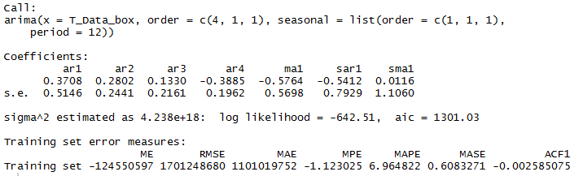
Stepwise approach Contd..
Time Series Decomposition
Build the Arima model by using different combinations of ACF and PACF values:
Here is the R code:
fit <- arima(T_Data_box, c(4, 1, 1),seasonal = list(order = c(1, 1, 1), period = 12) )
Here is the R output
Pick the model which has least AIC value.
AIC: The Akaike Information Criterion is a function to determine the best model. Lower the AIC is better the model.

Slide 20
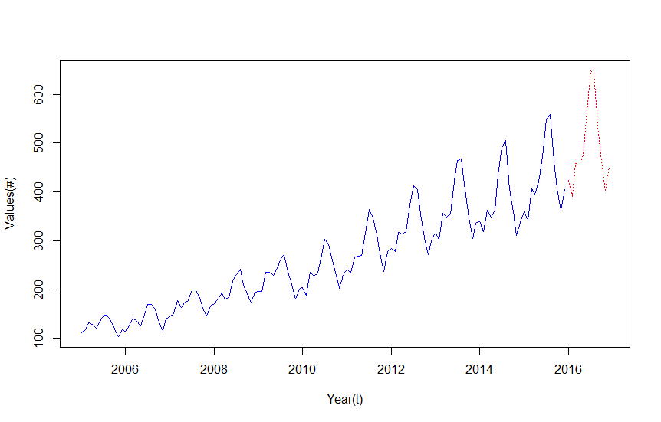
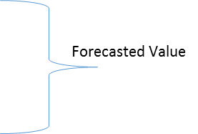
Stepwise approach Contd..
Time Series Decomposition
Forecast the data as per above model:
Here is the R code to forecast data for next 12 months.
pred_fit <- predict(fit, n.ahead = 1*12)
Merge Actual and Forecast in one series:
R Code:
comb <- ts.union(T_Data_box, pred_fit$pred)
final_t <-pmin(comb[,1], comb[,2], na.rm = TRUE)
Final step is to remove transformation from series:
R Code:
final_forecast <- exp(log(lambda * final_t + 1) / lambda)

Slide 21
Thank You

